Slide 1
June 1st Demo
Scope, Structure & Known Points

Slide 2
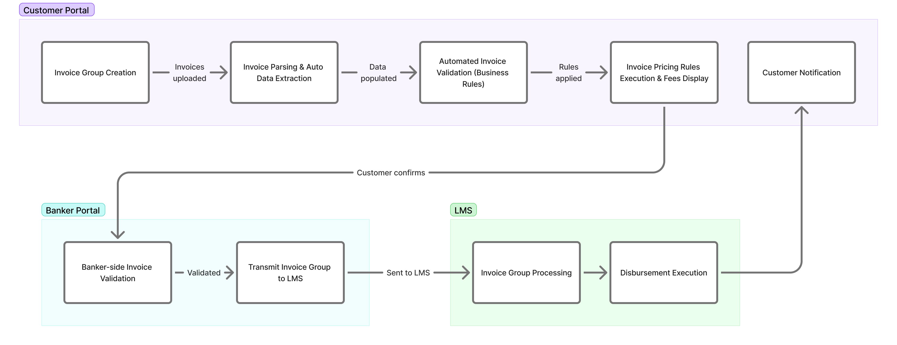
Demo Structure

Slide 3
Scope of May 21st Demo
Customer Portal
Invoice group creation initiated from the customer portal.
Execution of invoice pricing rules with applicable fees displayed to the customer.
Invoice parsing and automatic data extraction/population.
Automated invoice validation based on configured business rules.
Banker Portal
Banker-side invoice validation.
Transmission of the invoice group to the LMS.
LMS
Invoice group processing and disbursement executed within the LMS.
Disbursement status sent from LMS to LOS, followed by customer notification.

Slide 4
Known Points
The agreement formats shared by MAL are out of scope of this demo. Default templates are being used currently.
Embedded e-signing is not part of this demo. Biz2X is working on the same.
DBR and DSCR will be covered in the subsequent release.
Direct Debit Agreement is not getting sent for e-sign.
Murabaha Agreement content is of the default offer letter, and the execution is not working.
Supplier and Invoice metrics on the dashboard have not been integrated yet.
The invoice validation rules are running but not visible on UI on the banker portal for now.

Slide 5
Thank You

